Slide 1
What Distinguishes a Good Wine?
Polina Holland, Michelle Goodman, Tina Sparks, Taniya Chhabra

Slide 2
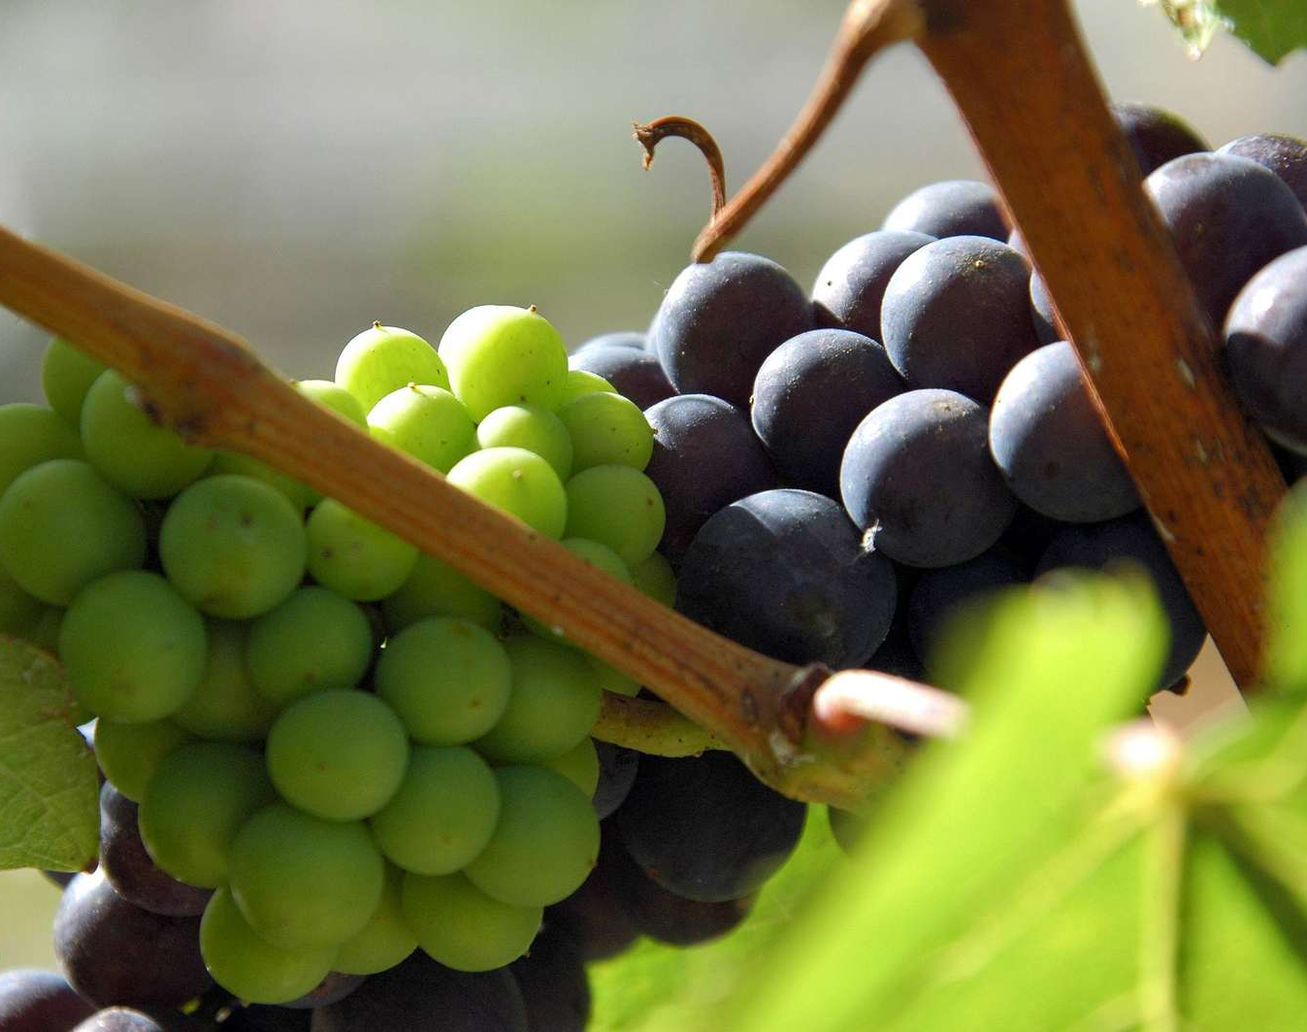
The What:
Who doesn’t love wine? As a group we decided to take a dataset from Kaggle that included over 6000 records of Puerto Rican wines and included features such as alcohol content, acidity, sugar, and color.
It also included a rating of the wine from 0-10. By using machine learning we able to create a model that could predict the rating of a wine based on the features.

Slide 3
First Things First
We used the process below to create our project:
Located a dataset large enough to work with
Lessened decimal points & restructured columns in the dataset
We determined the best machine learning model to use (K-Nearest Neighbors) and ran it against our data
Created visualizations using the data and the machine learning model by using matplotlib and Tableau.
Created two interactive visuals using Javascript and Streamlit
Used html to bring everything together in a visually attractive format.

Slide 4
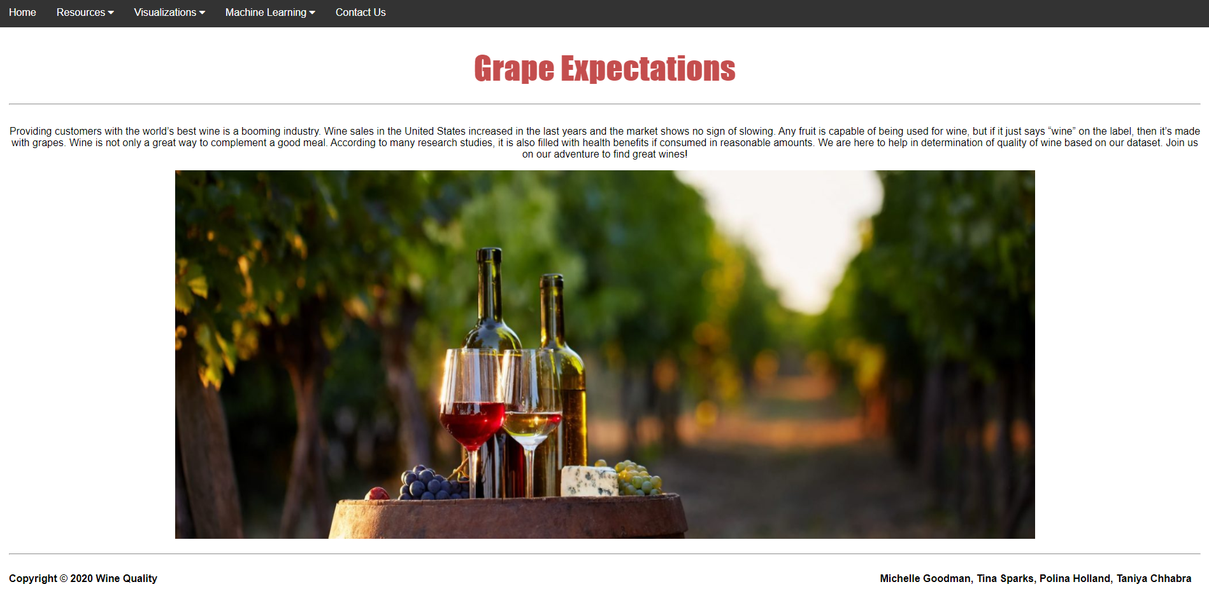
Let’s go to the Page!
Feel free to join us on our page as we talk through the various components of our project!
https://bea03013.github.io/GrapeExpectations/
(We will also share the link in the slack channel for easy access).

Slide 5
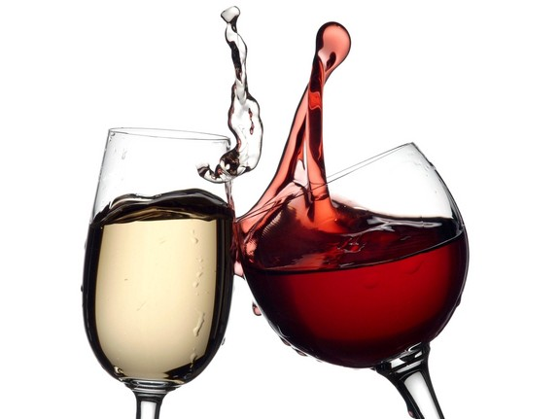
What Problems did we Run Into?
The biggest problem as we got started was finding a dataset that we liked that had enough data to run the machine learning model on.
There were some issues with Streamlit. It is a fairly new library and hasn’t gotten all of the bugs worked out.
We used Bootswatch on our filtered table, and found it caused issues with our Bootstrap Navigation Bar.
Figuring out the Procfile for the Heroku app and how to integrate it into our page was difficult.
But overall, we felt well-prepared to tackle the project and any troubleshoot any issues that arose!

Slide 6
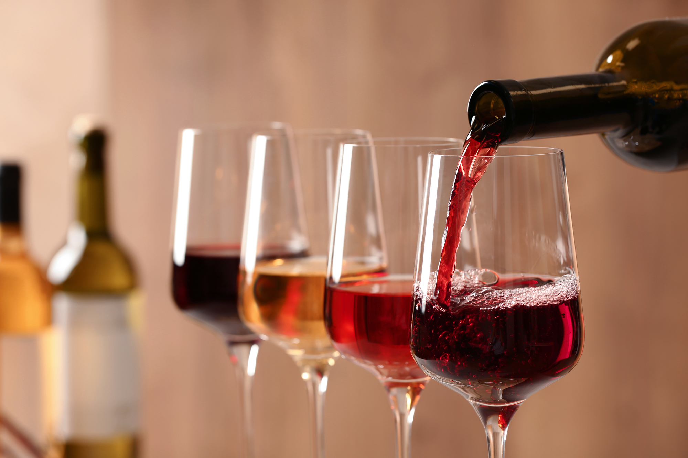
Any Questions?

